Slide 1
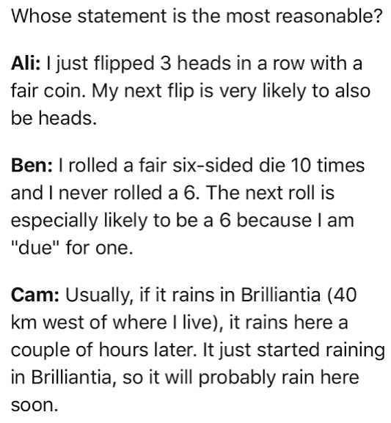
Warm up

Slide 2
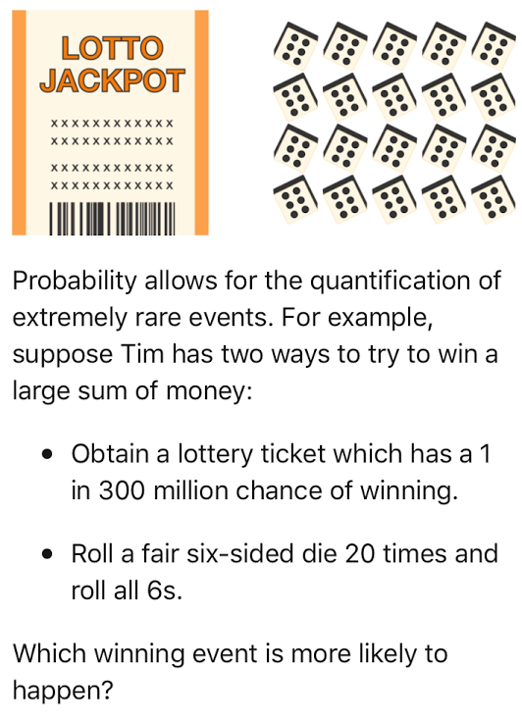

Slide 3
Unit 3: Applications of probability
LG 3-1: Conditional probability
LG 3-2: compound probability
Test 3/2/17

Slide 4
In this unit you will:
take your previously acquired knowledge of probability for simple and compound events and expand that to include conditional probabilities (events that depend upon and interact with other events) and independence.
be exposed to elementary set theory and notation (sets, subsets, intersection and unions).
use your knowledge of conditional probability and independence to make determinations on whether or not certain variables are independent

Slide 5
LG 3-1 Understandings:
Use set notation as a way to algebraically represent complex networks of events or real world objects.
Represent everyday occurrences mathematically through the use of unions, intersections, complements and their sets and subsets.
Use Venn Diagrams to represent the interactions between different sets, events or probabilities.
Find conditional probabilities by using a formula or a two-way frequency table.
Analyze games of chance, business decisions, public health issues and a variety of other parts of everyday life can be with probability.
Model situations involving conditional probability with two-way frequency tables and/or Venn Diagrams.

Slide 6
LG 3-1 Essential Questions:
How can I communicate mathematically using set notation?
In what ways can a Venn Diagram represent complex situations?
How can I use a Venn Diagram to organize various sets of data?
How can two-way frequency tables be useful?
How are everyday decisions affected by an understanding of conditional probability?
What options are available to me when I need to calculate conditional probabilities?
What connections does conditional probability have to independence?

Slide 7
Vocabulary, Set Notation, and Venn Diagrams

Slide 8
Probability
A number from 0 to 1
As a percent from 0% to 100%
Indicates how likely an event will occur

Slide 9
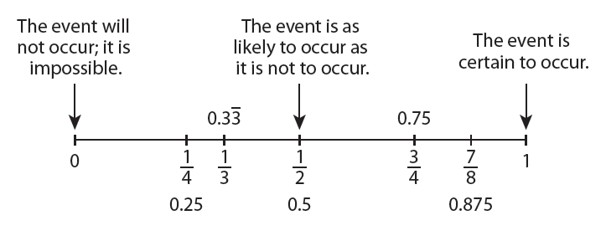
Diagram from Walch Education

Slide 10
Experiment
Any process or action that has observable results.
Example: drawing a card from a deck of cards is an experiment

Slide 11
Outcomes
Results from experiments
Example: all the cards in the deck are possible outcomes

Slide 12
Sample Space
The set (or list) of all possible outcomes.
Also known as the universal set
Example: listing out all the cards in the deck would be the sample space

Slide 13
Event
A subset of an experiment
An outcome or set of desired outcomes
Example: drawing a single Jack of hearts

Slide 14
Set
List or collection of items

Slide 15
Subset
List or collection of items all contained within another set
Denoted by A⊂B, if all the elements of A are also in B.

Slide 16
Empty Set
A set that has NO elements
Also called a null set.
Denoted by ∅

Slide 17
Union
Denoted by ∪
To unite
Everything in both sets

Slide 18
Intersection
Denoted by ∩
Only what the sets share in common

Slide 19
Complement
Denoted 2 different ways
Everything OUTSIDE of this set

Slide 20
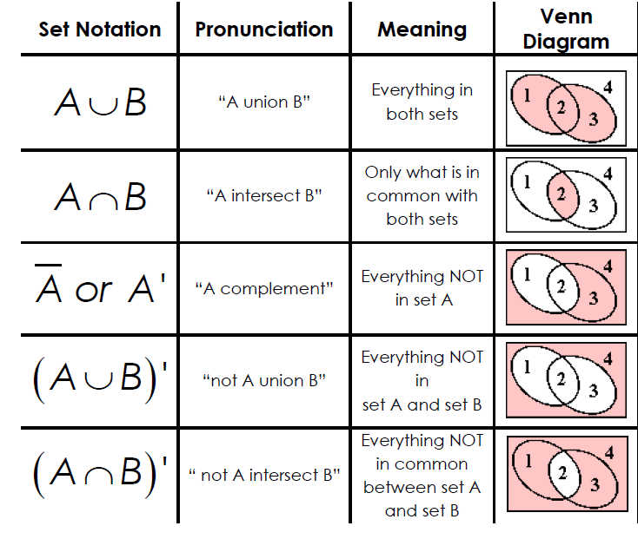
Set Notation Handout
Answer

Slide 21
Hector has entered the following names in the contact list of his new cellphone: Alicia, Brisa, Steve, Don, and Ellis.
B: The name begins with a vowel.
E: The name ends with a vowel.
1. Draw a venn diagram to represent this.
B
E
Brisa
Steve
Ellis
Alicia
Don

Slide 22
Hector has entered the following names in the contact list of his new cellphone: Alicia, Brisa, Steve, Don, and Ellis.
B: The name begins with a vowel.
E: The name ends with a vowel.
2. List the outcomes of B.
B = {Ellis, Alicia}

Slide 23
Hector has entered the following names in the contact list of his new cellphone: Alicia, Brisa, Steve, Don, and Ellis.
B: The name begins with a vowel.
E: The name ends with a vowel.
3. List the outcomes of E.
E = {Alicia, Brisa, Steve}

Slide 24
Hector has entered the following names in the contact list of his new cellphone: Alicia, Brisa, Steve, Don, and Ellis.
B: The name begins with a vowel.
E: The name ends with a vowel.
4. List the outcomes of B∩E.
B∩E = {Alicia}

Slide 25
Hector has entered the following names in the contact list of his new cellphone: Alicia, Brisa, Steve, Don, and Ellis.
B: The name begins with a vowel.
E: The name ends with a vowel.
5. List the outcomes of B∪E.
B∪E = {Ellis, Alicia, Brisa, Steve}

Slide 26
Hector has entered the following names in the contact list of his new cellphone: Alicia, Brisa, Steve, Don, and Ellis.
B: The name begins with a vowel.
E: The name ends with a vowel.
6. List the outcomes of B’.
B’= {Brisa, Steve, Don}

Slide 27
Hector has entered the following names in the contact list of his new cellphone: Alicia, Brisa, Steve, Don, and Ellis.
B: The name begins with a vowel.
E: The name ends with a vowel.
7. List the outcomes of (B∪E)’.
(B∪E)’ = {Don}

Slide 28
Classwork Worksheet
Using Venn Diagrams

Slide 29
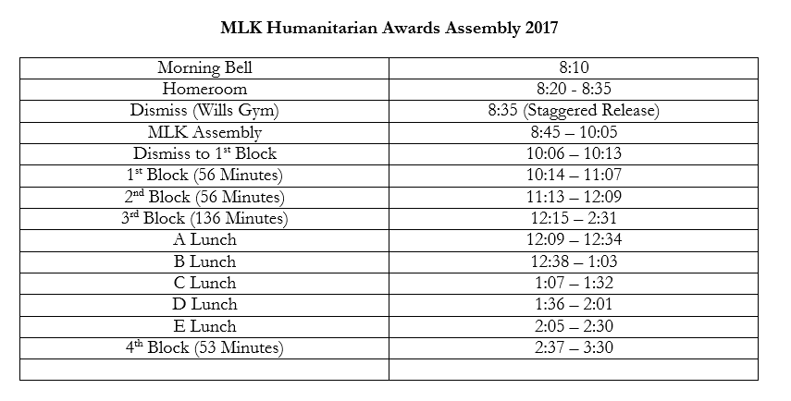

Slide 30
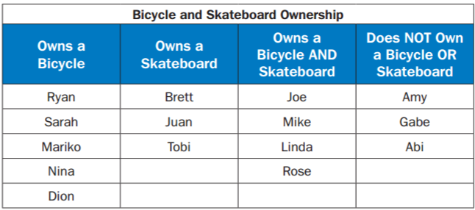
Warm UP
This table shows the names of students in Mr. Leary’s class who do or do not own bicycles and skateboards. Let set A be the names of students who own bicycles, and let set B be the names of students who own skateboards.
Find A and B. What does the set represent?
Find A or B. What does the set represent?
Find (A or B)′. What does the set represent?

Slide 31
Mutually Exclusive VS. Overlapping

Slide 32
Compound Probability
A compound event combines two or more events, using the word and or the word or.

Slide 33
Mutually Exclusive vs. Overlapping
If two or more events cannot occur at the same time they are termed mutually exclusive.
  They have no common outcomes.
Overlapping events have at least one common outcome.
Also known as inclusive events.

Slide 34
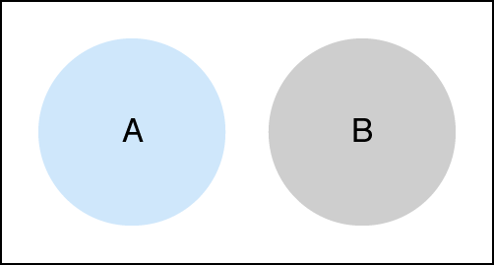
Mutually Exclusive Formula
P(A or B) = P(A) + P(B)

Slide 35
OR
Means you ADD

Slide 36
Example 1:
Find the probability that a girl’s favorite department store is Macy’s or Nordstrom.
Find the probability that a girl’s favorite store is not JC Penny’s.
Macy’s | 0.25
Saks | 0.20
Nordstrom | 0.20
JC Penny’s | 0.10
Bloomingdale’s | 0.25

Slide 37
Sum of Rolling 2 Dice
 | 1 | 2 | 3 | 4 | 5 | 6
1 | 2 | 3 | 4 | 5 | 6 | 7
2 | 3 | 4 | 5 | 6 | 7 | 8
3 | 4 | 5 | 6 | 7 | 8 | 9
4 | 5 | 6 | 7 | 8 | 9 | 10
5 | 6 | 7 | 8 | 9 | 10 | 11
6 | 7 | 8 | 9 | 10 | 11 | 12

Slide 38
Example 2:
When rolling two dice find
P(sum 4 or sum 5)
 | 1 | 2 | 3 | 4 | 5 | 6
1 | 2 | 3 | 4 | 5 | 6 | 7
2 | 3 | 4 | 5 | 6 | 7 | 8
3 | 4 | 5 | 6 | 7 | 8 | 9
4 | 5 | 6 | 7 | 8 | 9 | 10
5 | 6 | 7 | 8 | 9 | 10 | 11
6 | 7 | 8 | 9 | 10 | 11 | 12

Slide 39

Deck of Cards
52 total cards
4 Suits
13 cards in each suit
3 Face cards in each suit

Slide 40
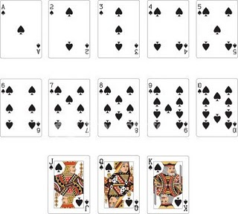
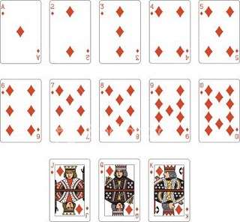
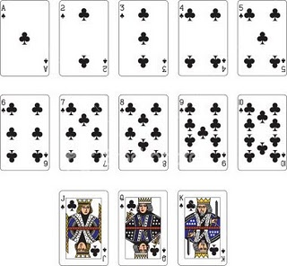
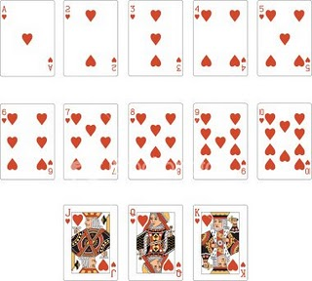

Slide 41
Example 3:
In a deck of cards, find
P(Queen or Ace)

Slide 42
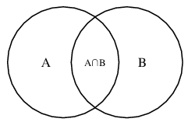
Overlapping Events Formula
P(A or B)
P(A ∪ B) = P(A) + P(B) – P(A ∩ B)

Slide 43
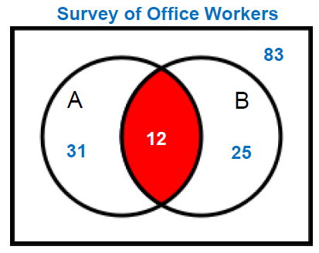
Example 4:
Find the probability that a person will drink both.
A = drink coffee
B = drink soda

Slide 44
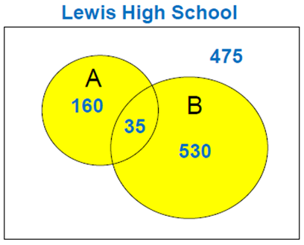
Example 5:
Find the P(A ∪ B)
A = band members
B = club members

Slide 45
Example 6:
In a deck of cards find
P(King or Club)

Slide 46
Example 7:
Find the P(picking a female or a person from Florida).
 | Female | Male
FL | 8 | 4
AL | 6 | 3
GA | 7 | 3

Slide 47
Example 8:
When rolling 2 dice, find P(an even sum or a number greater than 10).
 | 1 | 2 | 3 | 4 | 5 | 6
1 | 2 | 3 | 4 | 5 | 6 | 7
2 | 3 | 4 | 5 | 6 | 7 | 8
3 | 4 | 5 | 6 | 7 | 8 | 9
4 | 5 | 6 | 7 | 8 | 9 | 10
5 | 6 | 7 | 8 | 9 | 10 | 11
6 | 7 | 8 | 9 | 10 | 11 | 12

Slide 48
Example 9: Complementary Events
Find

Slide 49
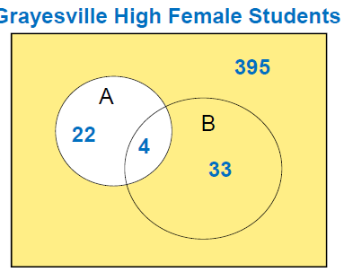
Example 10: Complementary Events
A = plays volleyball
B = plays softball
What is the probability that a female does not play volleyball?

Slide 50
Mutually Exclusive Practice WS
Use your notes to help you out.

Slide 51
Using Venn Diagrams HW WS
Use your notes to help you out.

Slide 52
Warm up!
A guidance counselor is planning schedules for 30 students. 16 say they want to take French, 16 want to take Spanish, and 11 want to take Latin. 5 say they want to take both French and Latin, and of these, 3 want to take Spanish as well. 5 only want Latin and 8 only want Spanish. How many students want French only?

Slide 53
Warm up take 2!
A new guidance counsellor is planning schedules for 23 language students, each of which must take at least one of the three offerings. It turns out that 15 students say they want to take French, 14 want to take Spanish, and 12 want to take Latin. Seven say they want to take both French and Spanish, nine want Spanish and Latin, and 6 want French and Latin.
How many students want Latin only?
(b) How many students study at least two languages?
(c) How many students study French or Spanish?
(d) How many students study French and Spanish?

Slide 54
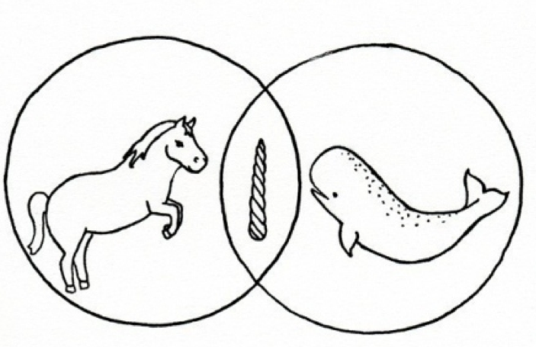
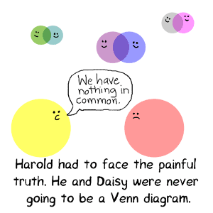
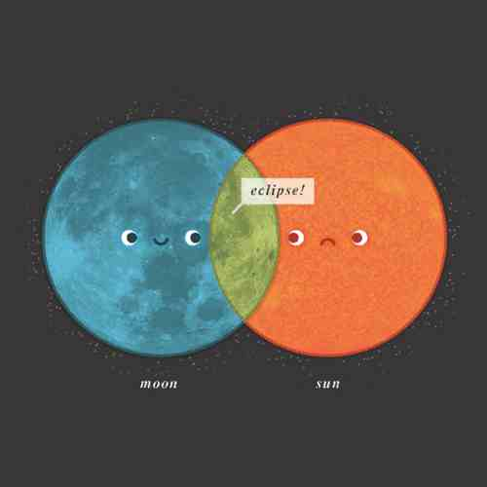
Mutually Exclusive and Overlapping Practice

Slide 55
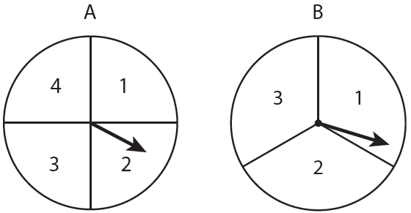
Warm-up
Howard is playing a carnival game. The object of the game is to predict the sum you will get by spinning spinner A and then spinner B.
List the sample space.
What is the probability Howard gets a sum of 5?
Suppose that Howard gets a 3 on Spinner A, what is the new probability of him getting a sum of 5?
3/12 or 1/4
1/3

Slide 56
The usefulness of probability…
Imagine the last time you entered to win a raffle at a fair or carnival. You look at your ticket, 562104. As they begin to call off the winning ticket, you hear 562, but everyone has the same first 3 digits. Then 1 and 0 are called off. You know that excited feeling you get? Did you know there is a lot of math behind that instinct you feel that you might just win the prize?
Now imagine those times when you are waiting to get your latest grade back on your English test. You’re really not sure how you did, but as your teacher starts to talk about test results, her body language just isn’t positive. She keeps saying things like “well, you guys tried hard.” Again, there is significant math happening behind that sinking feeling you now have.
Probability can be used to formalize the way real-life conditions change the way we look at the world

Slide 57
Conditional Probability
Contains a condition that limits (or restricts) the sample space for an event

Slide 58
Conditional Probability
Written as
“The probability of event B, given event A”

Slide 59
Conditional Probability Formula

Slide 60
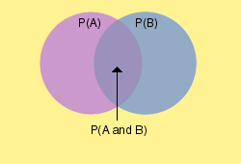
Conditional Probability Example
Diagnosis using a clinical test
Sample Space = all patients tested
  Event A: Subject has disease
  Event B: Test is positive
Interpret:
      Probability patient has disease and positive test (correct!)
      Probability patient has disease BUT negative test (false negative)
      Probability patient has no disease BUT positive test (false positive)
      Probability patient has disease given a positive test
      Probability patient has disease given a negative test

Slide 61
The table shows the results of a class survey, “Do you own a pet?”
Find P(own a pet | female).
Total of 14 Females. How many in this group own a pet?
 | Yes | No
Female | 8 | 6
Male | 5 | 7

Slide 62
The table shows the results of a class survey, “Did you wash the dishes last night?” Find P(wash the dishes | male).
Total of 15 males. How many in this group washed the dishes
 | Yes | No
Female | 7 | 6
Male | 7 | 8

Slide 63
Using the data in the table, find the probability (as a percent) that a sample of not recycled waste was plastic. P(plastic | not-recycled).
Total of not recycled 156.3. How many in this group waste was plastic?
 | Recycled | Not Recycled
Paper | 34.9 | 48.9
Metal | 6.5 | 10.1
Glass | 2.9 | 9.1
Plastic | 1.1 | 20.4
Other | 15.3 | 67.8

Slide 64
Unit 1 Reassessments
Your error analysis and remediation is due tomorrow in class.
If you do not turn these in, you will not be eligible to reassess on Wednesday.

Slide 65
Classwork
Practice Worksheet

Slide 66
Homework
Worksheet

Slide 67
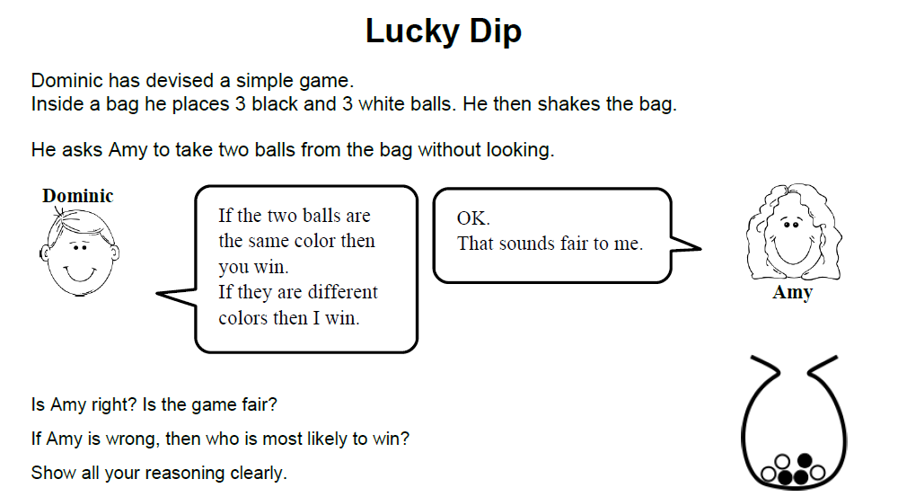
Warm UP
Notes:
• Can you think of a suitable diagram that will show all the possible outcomes?
Does it make a difference whether Amy picks the balls one at a time, rather than at the same time? Explain your answer.
Is it possible to select the same ball twice?

Slide 68
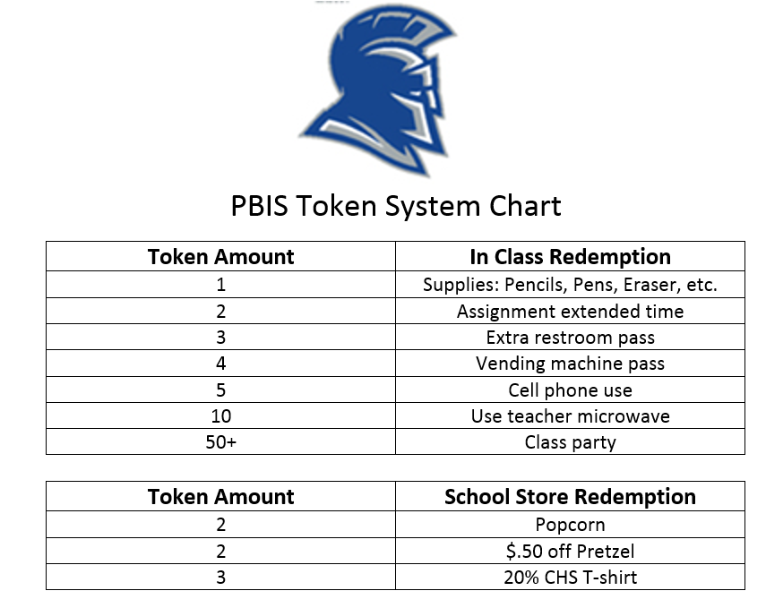

Slide 69
The following are student responses to this problem. Answer these questions:
Imagine you are the teacher and have to assess the students’ work.
Explain what the student has done.
What isn’t clear about his/her work?
What mistakes has he/she made?

Slide 70
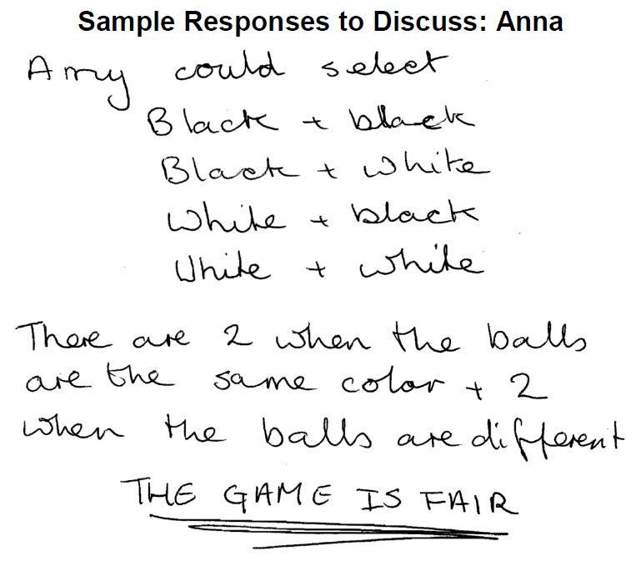
Notes:
Anna’s work appears intuitively correct. She assumes that there are only two outcomes (that the two balls are the same color or that they are different colors), so that the probabilities are equal. Anna does not take into account the changes in probabilities once a ball is removed from the bag and not replaced.

Slide 71
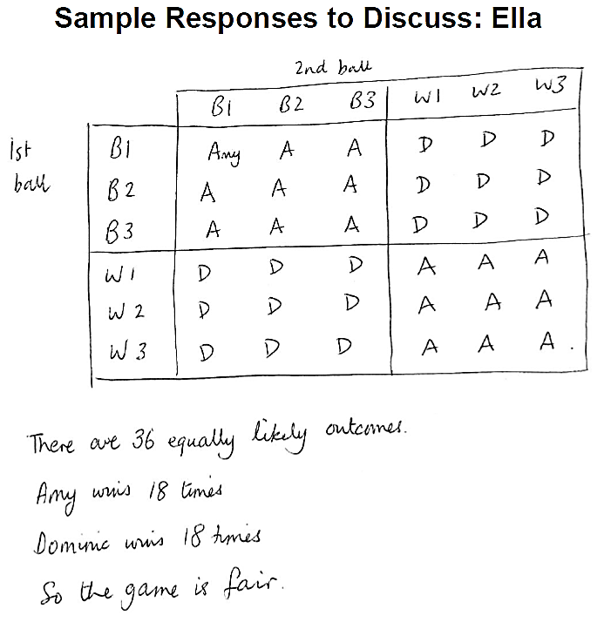
Notes:
Ella clearly presents her work, however she makes the mistake of including the diagonals. This means the same ball is selected twice. This is not possible, as the balls are not replaced.

Slide 72
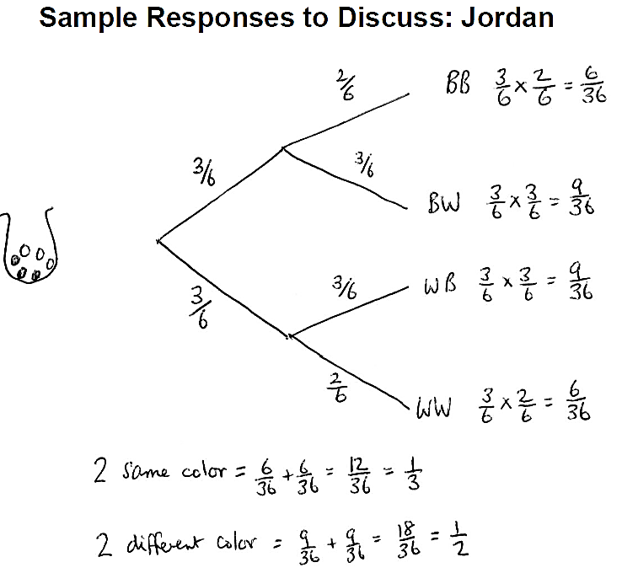
Notes:
Jordan’s work is difficult to follow. He does not label the branches of the tree. Jordan does not take into account that the first ball is not replaced. When selecting the second ball there are only 5 balls in the bag, so these probability fractions should all have a denominator of 5.
Where does the denominator of 6 come from? What is the sum of all final probabilities? What does this tell you about Jordan’s work? [He has made a mistake.]

Slide 73
In conclusion…
Now that you have seen Amy’s, Ella’s and Jordan’s work, what would you do if you started the task again?
Would you change your answer? Do you think Amy is right?
Notes:
Amy is wrong: the game is not fair.

Slide 74
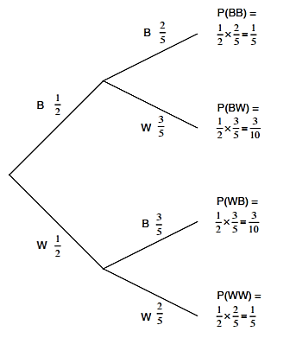
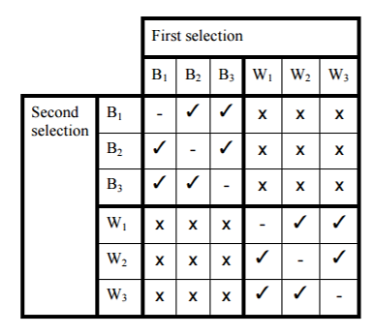
Different Representations

Slide 75
Conditional Probability
Say-No-To-Smoking campaigns educate the public about the adverse health effects of smoking cigarettes.
This motivation has its beginnings in data analysis.
The following table represents a sample of 500 people.
Distinctions are made on whether or not a person is a smoker and whether or not they have ever developed lung cancer.

Slide 76
Conditional Probability
 | Has been a smoker for 10+ years | Has not been a smoker
Has not developed lung cancer | 202 | 270
Has developed lung cancer | 23 | 5
How does the table indicate that there is a connection between smoking and lung cancer?
2. Use the data in this table to complete the worksheet with a partner.

Slide 77
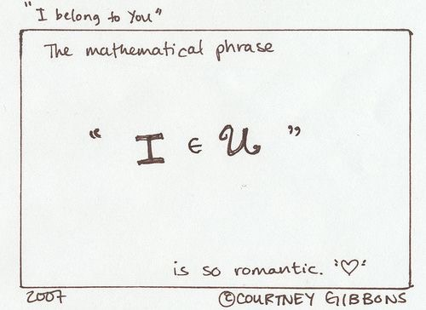
Unit 1 Reassessments
Please turn in your Error Analysis and Remediation
Also, sign up on the sheet and indicate which learning goals you will be reassessing.

Slide 78
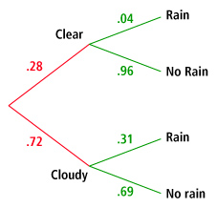
Using Tree Diagrams
Jim created the tree diagram after examining years of weather observations in his hometown. The diagram shows the probability of whether a day will begin clear or cloudy, and then the probability of rain on days that begin clear and cloudy.
Find the probability that a day will start out clear,
and then will rain.
1%.
b. Find the probability that it will not rain on any given day.
77%.

Slide 79
You Try One
A survey of Pleasanton Teenagers was given.
  60% of the responders have 1 sibling; 20% have 2 or more siblings
  Of the responders with 0 siblings, 90% have their own room
  Of the respondents with 1 sibling, 20% do not have their own room
  Of the respondents with 2 siblings, 50% have their own room
  Create a tree diagram and determine
  P(own room | 0 siblings)
  P(share room | 1 sibling)

Slide 80
Warm up
The following table shows the number of people that like a particular fast food restaurant.
 | McD’s | BK | Wendy’s
Male | 20 | 15 | 10
Female | 20 | 10 | 25
1. What is the probability that a person likes Wendy’s?
7/20
2. What is the probability that a person is male given they like BK?
3. What is the probability that a person is male and likes BK?
4. What is the probability that a randomly chosen person is female or likes McDonald’s?
3/5
3/20
3/4

Slide 81

Queeeeez time

Slide 82
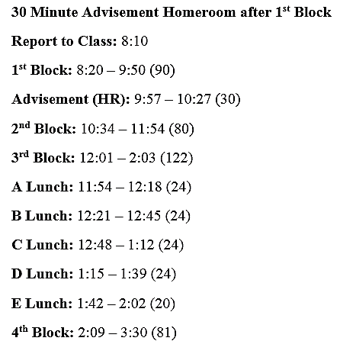
Today’s bell schedule

Slide 83
LG 3-2 Understandings:
Understand independence as conditional probabilities where the conditions are irrelevant.
Confirm independence of variables by comparing the product of their probabilities with the probability of their intersection.

Slide 84
LG 3-2 Essential Questions:
What makes two random variables independent?
How do I determine whether or not variables are independent?

Slide 85
Probability
Independent and Dependent Events

Slide 86
Independent Events
A occurring does NOT affect the probability of B occurring.
“AND” means to MULTIPLY!

Slide 87
Independent Event FORMULA
P(A and B) = P(A) • P(B)
also known as
P(A ∩ B) = P(A)  P(B)

Slide 88
Example 1
A coin is tossed and a 6-sided die is rolled. Find the probability of landing on the head side of the coin and rolling a 3 on the die. P(Head and 3)
P(A ∩ B) = P(A)  P(B)

Slide 89
Example 2
A card is chosen at random from a deck of 52 cards. It is then replaced and a second card is chosen. What is the probability of choosing a jack and an eight?
P(Jack and 8)
P(A ∩ B) = P(A)  P(B)

Slide 90
Example 3
A jar contains 3 red, 5 green, 2 blue and 6 yellow marbles. A marble is chosen at random from the jar. After replacing it, a second marble is chosen. What is the probability of choosing a green and a yellow marble?
P(Green and Yellow)
P(A ∩ B) = P(A)  P(B)

Slide 91
Example 4
A school survey found that 9 out of 10 students like pizza. If three students are chosen at random with replacement, what is the probability that all three students like pizza? P(Like and Like and Like)

Slide 92
Dependent Events
A occurring AFFECTS the probability of B occurring
Usually you will see the words “without replacing”
“AND” still means to MULTIPLY!

Slide 93
Dependent Event Formula
P(A and B) = P(A) • P(B given A)
also known as
P(A ∩ B) = P(A)  P(B|A)

Slide 94
Example 5
A jar contains 3 red, 5 green, 2 blue and 6 yellow marbles. A marble is chosen at random from the jar. A second marble is chosen without replacing the first one. What is the probability of choosing a green and a yellow marble?
P(Green and Yellow)
P(A ∩ B) = P(A)  P(B|A)

Slide 95
Example 6
An aquarium contains 6 male goldfish and 4 female goldfish. You randomly select a fish from the tank, do not replace it, and then randomly select a second fish. What is the probability that both fish are male? P(Male and Male)
P(A ∩ B) = P(A)  P(B|A)

Slide 96
Example 7
A random sample of parts coming off a machine is done by an inspector. He found that 5 out of 100 parts are bad on average. If he were to do a new sample, what is the probability that he picks a bad part and then, picks another bad part if he doesn’t replace the first? P(Bad and Bad)
P(A ∩ B) = P(A)  P(B|A)

Slide 97
Determining if 2 Events are Independent

Slide 98
Determining if Events are Independent
Substitute in what you know and check to see if left side equals right side.
P(A ∩ B) = P(A)  P(B)

Slide 99
Example 8
Let event M = taking a math class. Let event S = taking a science class. Then, M and S = taking a math class and a science class.
Suppose P(M) = 0.6, P(S) = 0.5, and P(M and S) = 0.3.
Are M and S independent?
Conclusion: Taking a math class and taking a science class are independent of each other.

Slide 100
Example 9
In a particular college class, 60% of the students are female. 50% of all students in the class have long hair. 45% of the students are female and have long hair. Of the female students, 75% have long hair. Let F be the event that the student is female. Let L be the event that the student has long hair. One student is picked randomly.
Are the events of being female and having long hair independent?
Conclusion: Being a female and having long hair are not independent.

Slide 101

Practice!

Slide 102
Get into your groups:
Jack Kef Xavi | Shelby Jesus Judith | Alejandro Elizabeth Lindsay Max
Thomas Liz Ciarra | Bonnie Ari Denise | Isabella Sidney Boston
Rosie Zoe Anju | Maribel Camille Katie | Olivia Tori Brooklin

Slide 103
Get into your groups:
Danielle Khushi Maidelid | Bella T. Sarina Naomi | Bella G. Danice Ian
Jimmy Tracey Bella S. | Angel Raquel Darlene | Maddy Kevin Hannah
Zoe Richard Gabriel Marilyn | Adam Oswaldo Trinity | Jordy Sophia Payton

Slide 104
Warm UP
A group of 60 students were asked if they played fieldhockey (F), basketball (B) or soccer (S). The diagram below displays the results.
Find the probability a student plays:
field hockey & soccer?
field hockey or soccer?
soccer & basketball?
All of the three sports?
only 1 sport?
Basketball given they play soccer?
F
18
4
2
3
7
5
10
B
S

Slide 105
Spinner Bingo!
Work with your group to complete the front (6) problems
Then work on the Spinner Bingo game on the back.

Slide 106
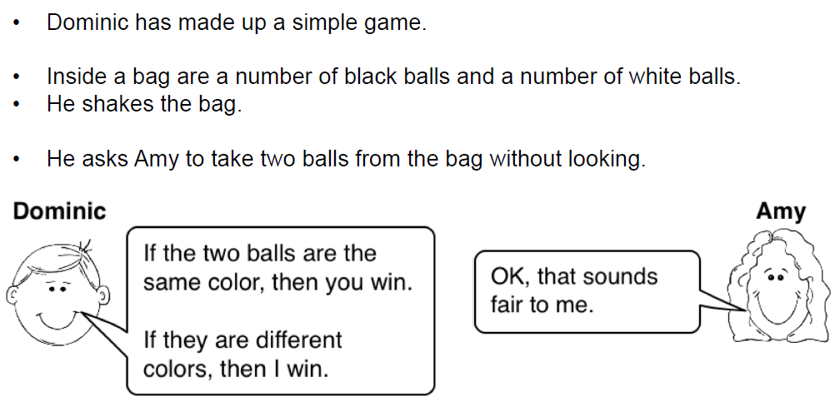
Make it fair…
Notes:
You are now going to continue with the same game you worked on in the warmup, but this time
there are some black balls already in the bag.

Slide 107
Working together…
Your task is to figure out how many white balls to add to the bag to make the game fair.
There may be more than one answer for each card.
Just choose some number of white balls. If that doesn’t make the game fair, think about why it doesn’t. Then try to find a different solution.
It is important that everyone in your group understands and agrees with the solution. If you don’t, explain why. You are responsible for each other’s learning.
Prepare a presentation of your problem and your work on a poster.

Slide 108
Warm up
83% of 16 year-olds have a cell phone and 63% have a cell phone and a car. What is the probability that a teenager has a car given that he or she also has a cell phone?
Maggie studies with a group for an upcoming math competition on Mondays, Tuesdays, and Thursdays. She also volunteers at a hospital on Mondays, Wednesdays, and Thursdays. Maggie’s science class is taking a field trip that could be scheduled for any day of the week (Monday through Friday). Find the probability that the field trip will be scheduled for a day that Maggie is studying for her math competition or volunteering at the hospital.
Johnny is playing a game and rolls a pair of dice. What is the probability that the sum of the dice rolled is either a 9 or a 5?

Slide 109
Independent vs. Dependent Practice

Slide 110
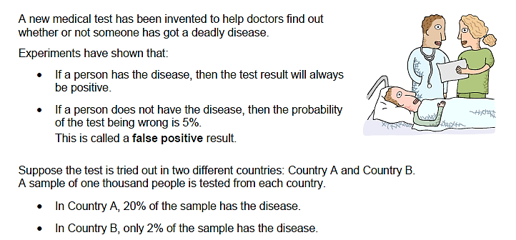
Medical Testing

Slide 111
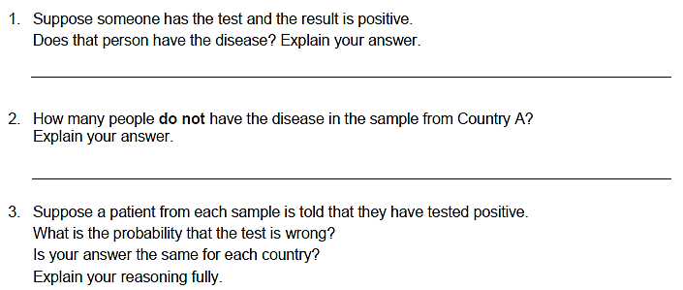
Medical Testing

Slide 112
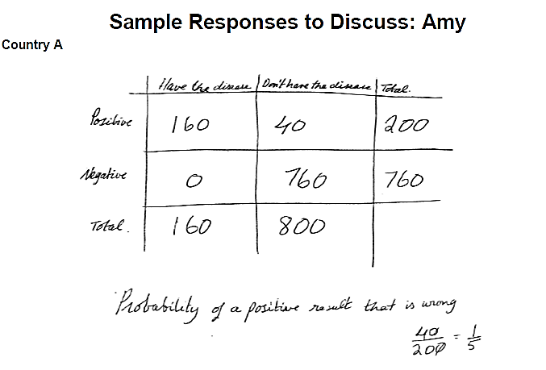
Notes:
Write some comments about Amy’s work.
Can you understand what she has done?
Try to correct her mistakes.
Use Amy’s method to calculate the probability of a positive test being wrong in Country B.

Slide 113
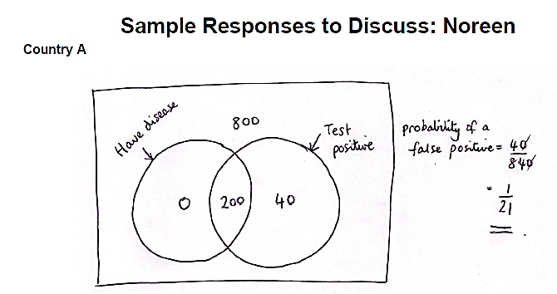
Notes:
Write some comments about Noreen’s work.
Can you understand what she has done?
Try to correct her mistakes.
Use Noreen’s method to calculate the probability of a positive test being wrong in Country B.

Slide 114
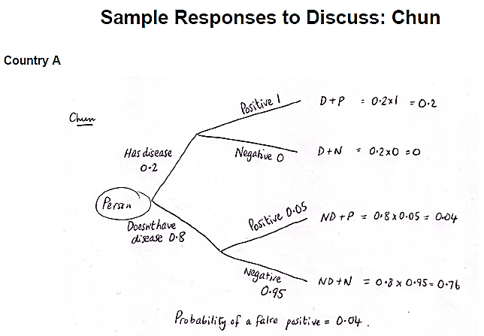
Notes:
Write some comments about Chun’s work.
Can you understand what she has done?
Try to correct her mistakes.
Use Chun’s method to calculate the probability of a positive test being wrong in Country B.

Slide 115
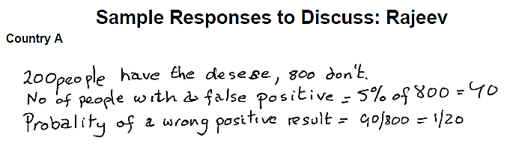
Notes:
Can you understand what Rajeev has done? What isn’t clear about his work?
What has he got right? What mistakes has he made?
Use Rajeev’s method to calculate the probability of a positive test being wrong in Country B.

Slide 116
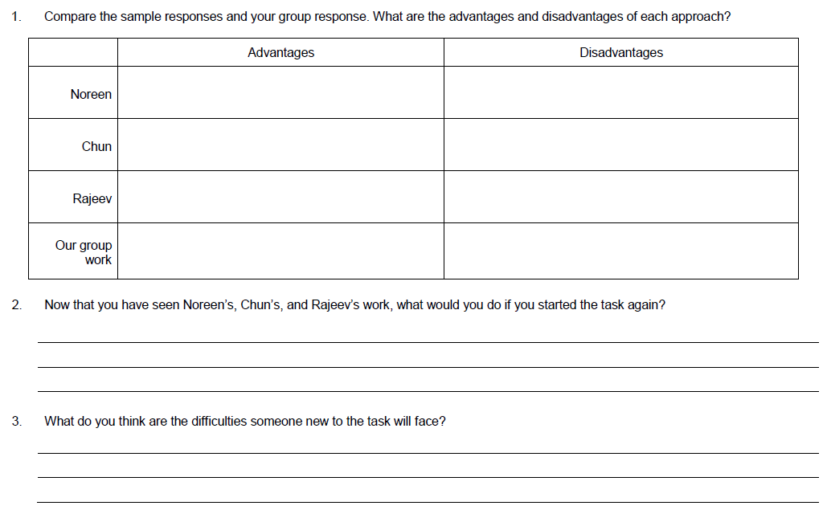

Slide 117
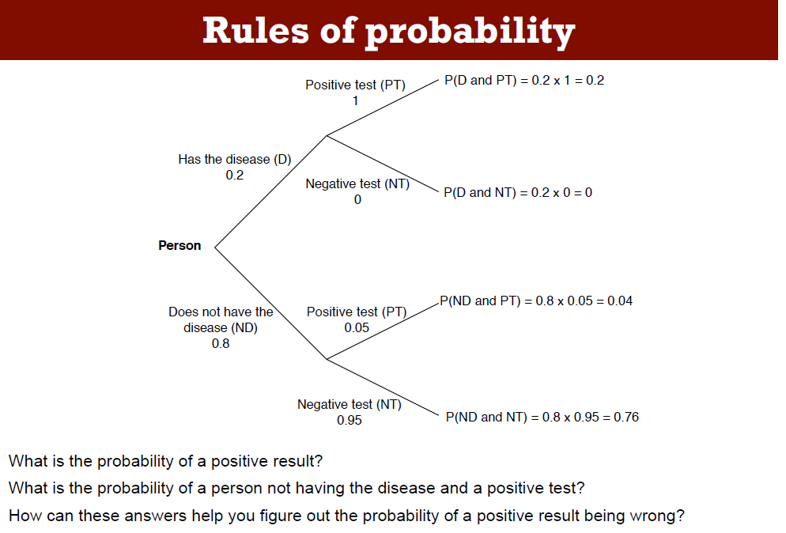

Slide 118
Probability Project for the Break!

Slide 119
Warm UP
Carrie writes each of the letters of the word MATHEMATICAL on individual index cards and places them into a bag. She randomly draws one letter from the bag, doesn’t replace it, and then randomly draws a second letter. What is the probability that the first letter is an “A” and the second letter is a “H” ?
A bag contains 8 orange balls and 7 purple balls. Josh randomly draws one ball replaces it, and randomly draws a second ball. What is the probability of the first ball being orange and the second ball being orange?

Slide 120
Group Activity
Read the situations in the card sets very critically and carefully. Your group should match each situation from card set to each type of compound probability. Once you are sure that you have completed the matching correctly, begin solving each of the situations to find the correct probability. Be prepared to justify your answers and to discuss

Slide 121
Answers to Card Sort
Independent 1, 5 | Dependent 3, 7
Conditional 4, 6, 8 | Mutually Exclusive 2, 9, 11
Overlapping 10, 12

Slide 122
Turn in your False Positive Project

Slide 123
Homework
Review sheet
Quiz Tomorrow!!!

Slide 124
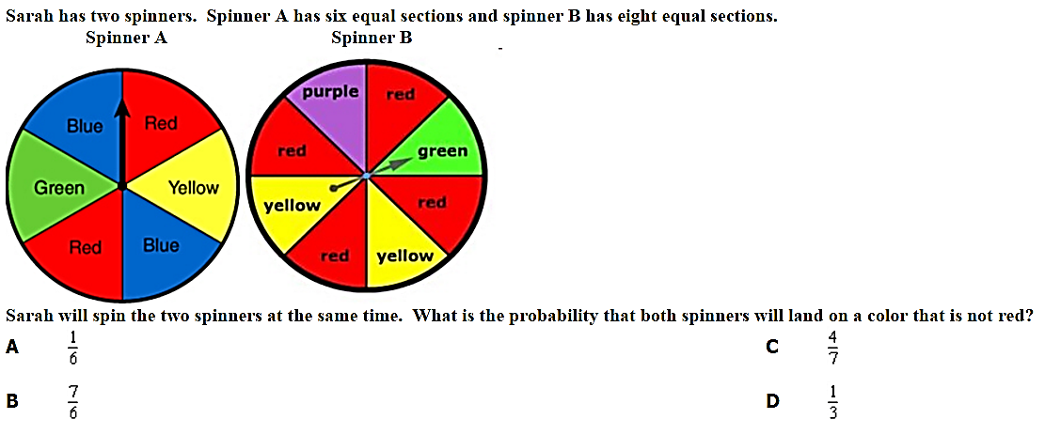
Warm UP

Slide 125
Unit 3 Review
Applications of Probability

Slide 126
Problem 1
A bag contains 3 red balls and 4 green balls. You randomly draw one ball, replace it and randomly draw a second ball.
Event A: The first ball is red.
Event B: The second ball is red.
3/7 * 3/7 =9/49

Slide 127
Problem 2
A pair of dice is being rolled. A possible event is rolling a sum of 5. What is the probability of the complement of this event?
1 – 4/36 = 8/9

Slide 128
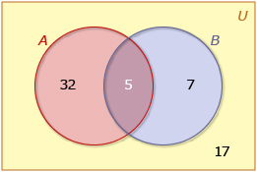
Problem 3
Use the Venn Diagram to find .
1 – 5/61
=56/61

Slide 129
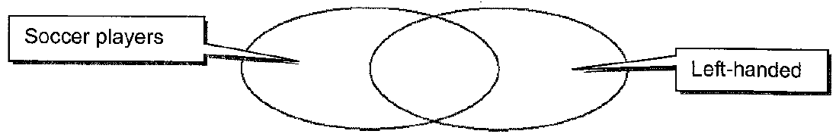
Problem 4
Of the 65 students going on the soccer trip, 43 are players and 12 are left-handed. Only 5 of the left-handed students are soccer players. What is the probability that one of the students on the trip is a soccer player or is left-handed?
38
5
7
43/65 + 12/65 – 5/65 = 10/13

Slide 130
Problem 5
Of the 400 doctors who attended a conference, 240 practiced family medicine, and 130 were from countries outside the United States. One-third of the family medicine practitioners were not from the United States.
What is the probability that a doctor practices family medicine or is from the United States?
240/400 + 110/400 = 7/8
50
160
Family Medicine
80
Outside the U.S.
110 – from the U.S.

Slide 131
Problem 6
The probability of a student playing badminton in PE class is 36%. The probability of a student playing football in PE is 38%. 48% of the students played at least one of the two sports during class.
What is the probability, as a percent, of a student playing both sports during the period?
48% = 36% + 38% - P(both)
= 26%

Slide 132
Problem 7
Bianca spins two spinners that have four equal sections numbered 1 through 4. If she spins a 4 on at least one spin, what is the probability that the sum of her two spins is an even number?
+ | 1 | 2 | 3 | 4
1 | 2 | 3 | 4 | 5
2 | 3 | 4 | 5 | 6
3 | 4 | 5 | 6 | 7
4 | 5 | 6 | 7 | 8
3/7

Slide 133
Problem 8
Mrs. Koehler surveyed 430 men and 200 women about their vehicles. Of those surveyed, 160 men and 85 women said they own a blue vehicle. If a person is chosen at random from those surveyed, what is the probability of choosing a woman or a person that does NOT own a blue vehicle?
Hint: Draw a two way frequency table.
 | Blue Car | Not Blue | TOTAL
Men | 160 | 270 | 430
Women | 85 | 115 | 200
TOTAL | 245 | 385 | 630
47/63
200/630 + 385/630 – 115/630

Slide 134
Problem 9
A random survey was conducted to gather information about age and employment status.
What is the probability that a randomly selected person surveyed is less than 18 years old, given that the person has a job?
20/607
Employment Survey Results
 | Age (in Years)
Employment Status | Less than 18 | 18 or greater | Total
Has Job | 20 | 587 | 607
Does Not Have Job | 245 | 92 | 337
Total | 265 | 679 | 944

Slide 135
Problem 10
Event A is choosing a heart card from a standard deck of cards.
Event B is choosing a face card from a standard deck of cards. Find .
 | Heart | Not a heart | Total
Face Card | 3 | 9 | 12
Not a face card | 10 | 30 | 40
Total | 13 | 39 | 52
13/52 + 12/52 – 3/52 = 11/26

Slide 136
Problem 11
For two events A and B, it is know that P(A) = 0.40 and .
Find P(B | A).
0.30 = 0.40 • P(B|A)
0.75 = P(B|A)

Slide 137
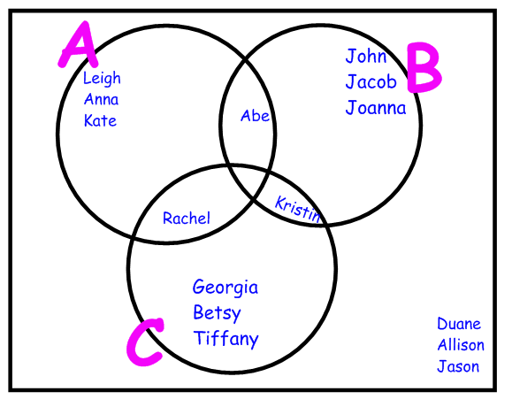
Problem 12
Let set A be the names of students who love the Georgia Bulldogs, let set B be the names of students who love the Florida Gators, and let set C be the names of students who love Clemson Tigers.
Find
5/15 + 5/15 – 1/15
= 3/5

Slide 138
Unit 2 retest tomorrow PM
Please turn in your error analysis and remediation if you plan on staying after school tomorrow to reassess.

Slide 139
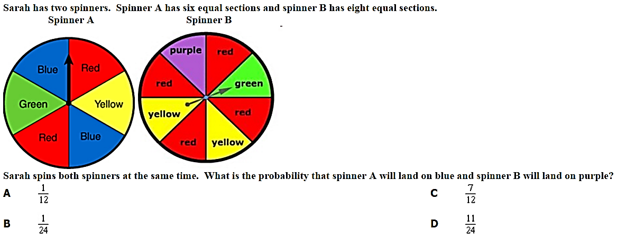
Warm Up

Slide 140
Queeeeez Time

Slide 141
Unit 2 retest today after school
Please turn in your error analysis and remediation if you plan on staying after school to reassess.

Slide 142
Conditional Probability Practice

Slide 143
Probability Touchstone

